Slide 1

Babu Banarasi Das University
Submitted for the partial fulfillment
of
Bachelor of Technology
in
Computer Science & Engineering
Presented By : Guided By:
Shivangi Shukla (1180432102) Mr. Ravi Krishan Pandey
Mansi Kumari (1180432069) (Assistant Professor)
Tarani Yadav (1180432102)

Slide 2
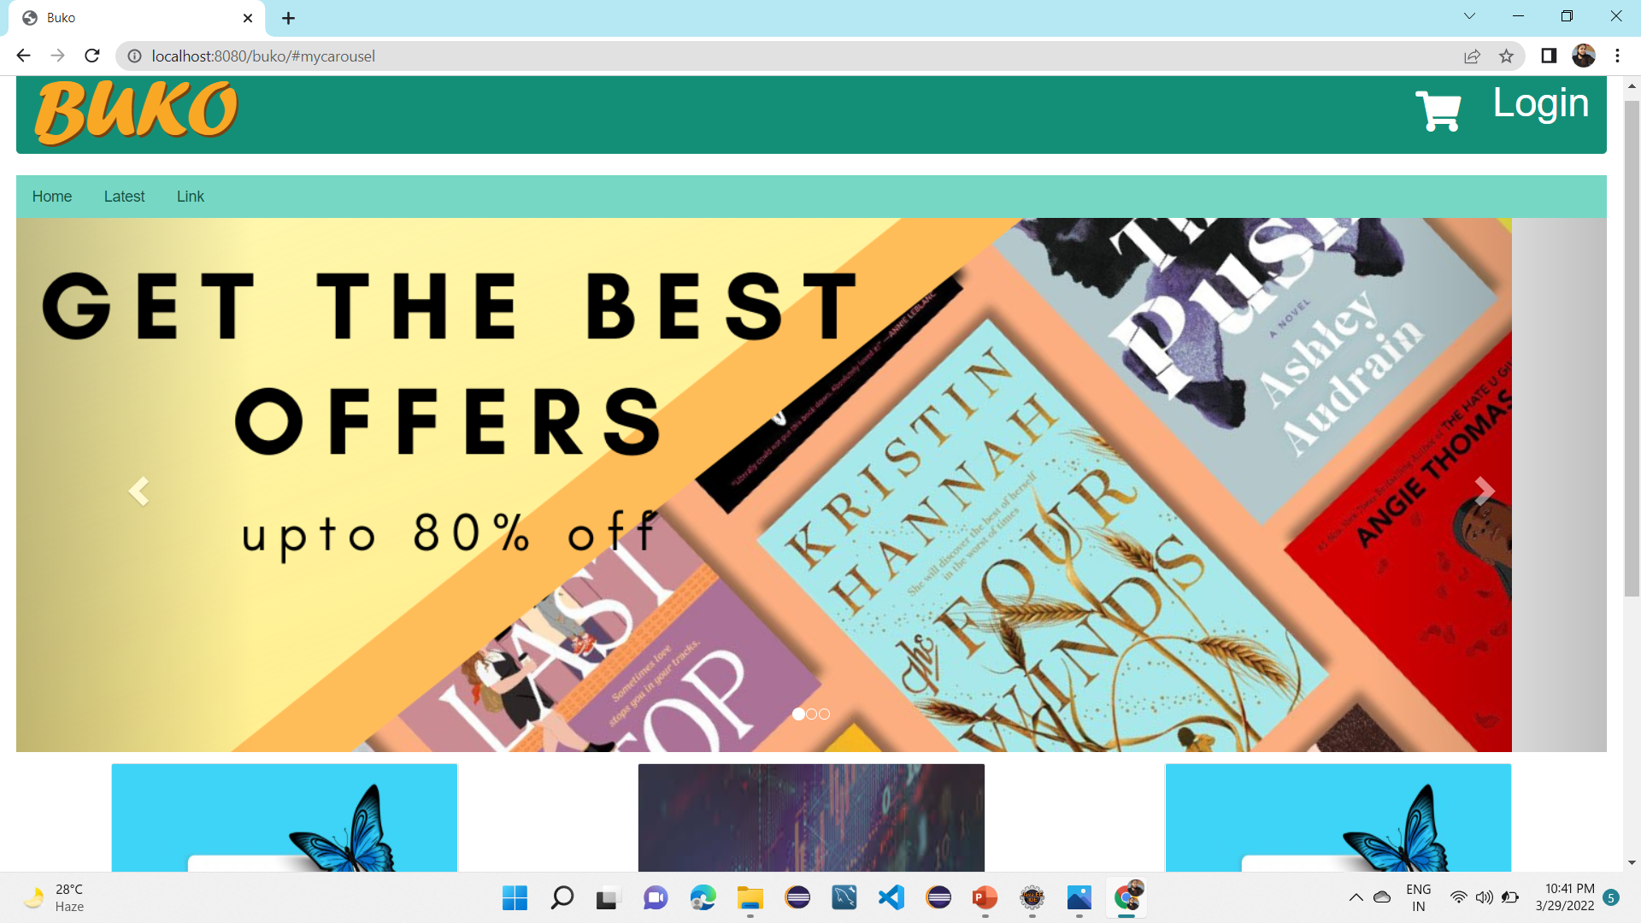
Buko
Designed By: Mansi Kumari, Shivangi Shukla,Tarani Yadav
Project Guide: Mr. Ravi Krishan Pandey

Slide 3
CONTENTS

Slide 4
INTRODUCTION
If someone will ask “What your website do ?” the answer will likely we are creating a online book portal ; where a book lover can read all his/her favourites book , with a very minimal searching because all the books are easily available here.
They can Read the books .
If a reader wants to add the book he can .
User can easily add a books in cart and download also .
User friendly website.
All the books are available in the pdf form only.
A Uploader who uploads all the books ,if he wants he can also reads the books of his choices.

Slide 5
FEATURES
Admin:
Admin who manages all the portal which is viewing , modifying , maintaining stocks etc.
Users :
Users can easily do registration & login ,create profile.
Users can easily add, update or delete pdf for Books ,Stock.
Users(Buyers) can easily view books and catalogue.
HERE ARE :
Facility to download required books.
Can make order & Give ratings and reviews.
Editing, Adding and Updating of records is improved which results in proper resource management of Books data.
Decrease the load of the person involve in existing manual system.
Works become very speedy.
Shows the information and description of the Books, Payment.

Slide 6
PROJECT OBJECTIVE
The project aims to develop a online portal which is very beneficial for the writer and readers.
The Online portal is to manage the details of Books and users.
The purpose of the project is to build an application program to reduce the manual work for managing the Books, Customer, Stock.

Slide 7
Tools & Technologies
Html
CSS
BOOTStrap
JAVA SCRIPT
JSP
SERVLET
SQL

Slide 8
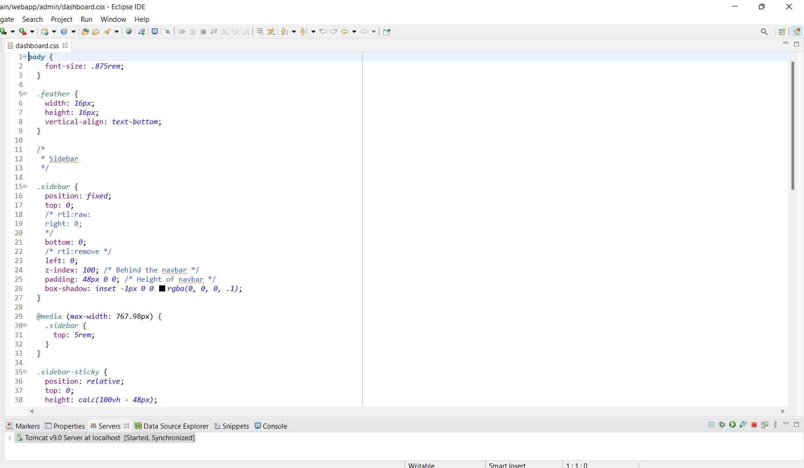
Dashboard

Slide 9
Dashboard

Slide 10
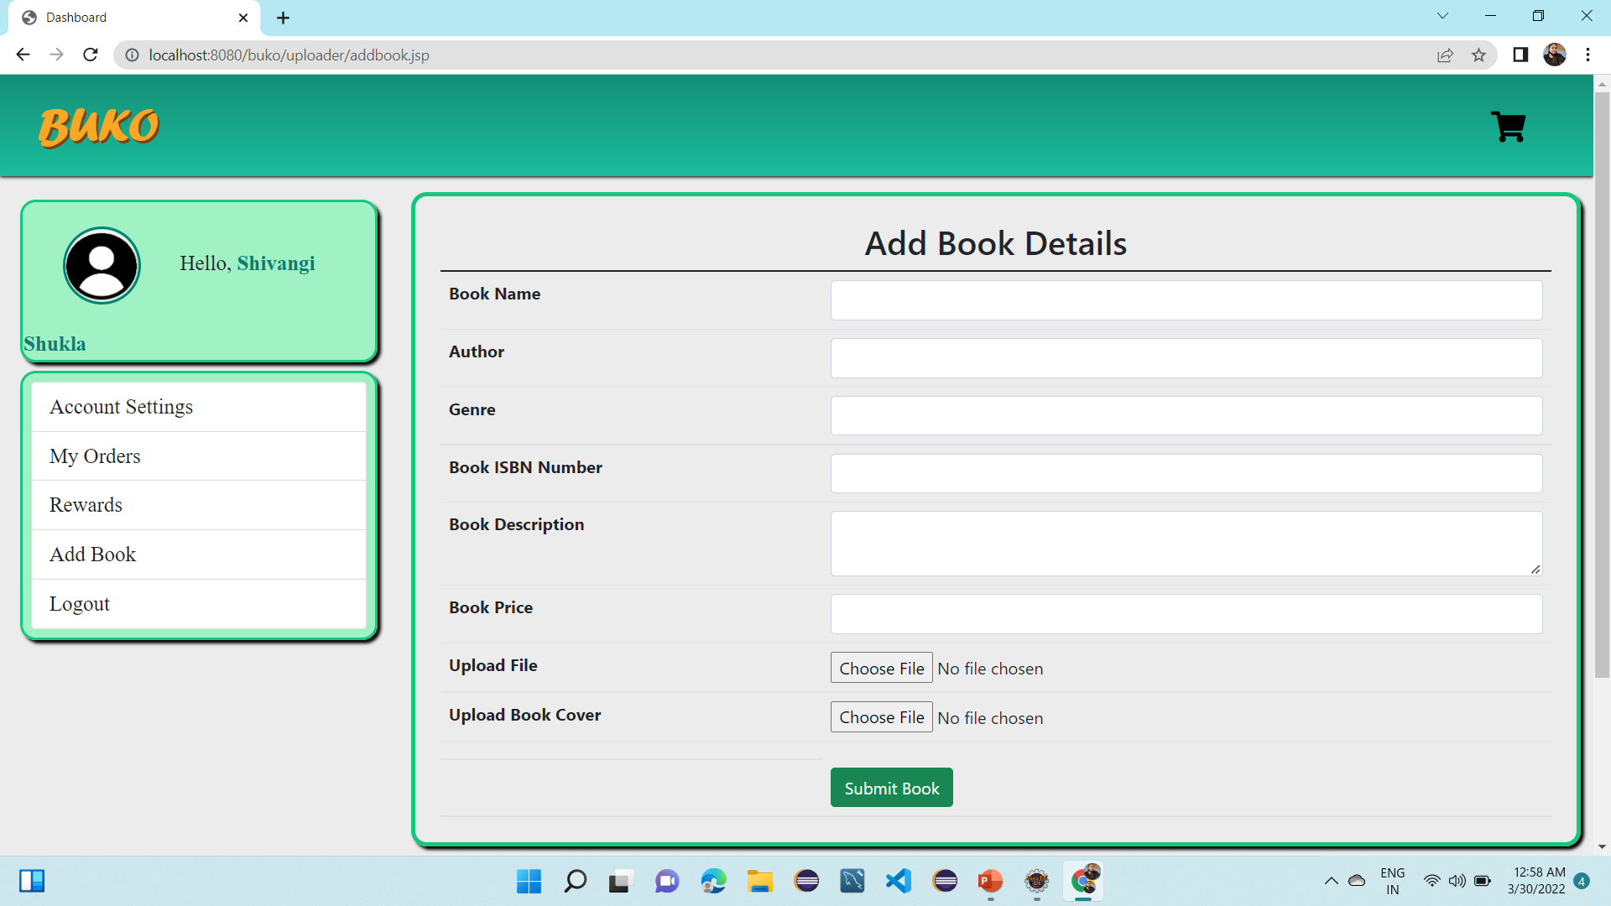
DASHBOARD-Add Book details

Slide 11
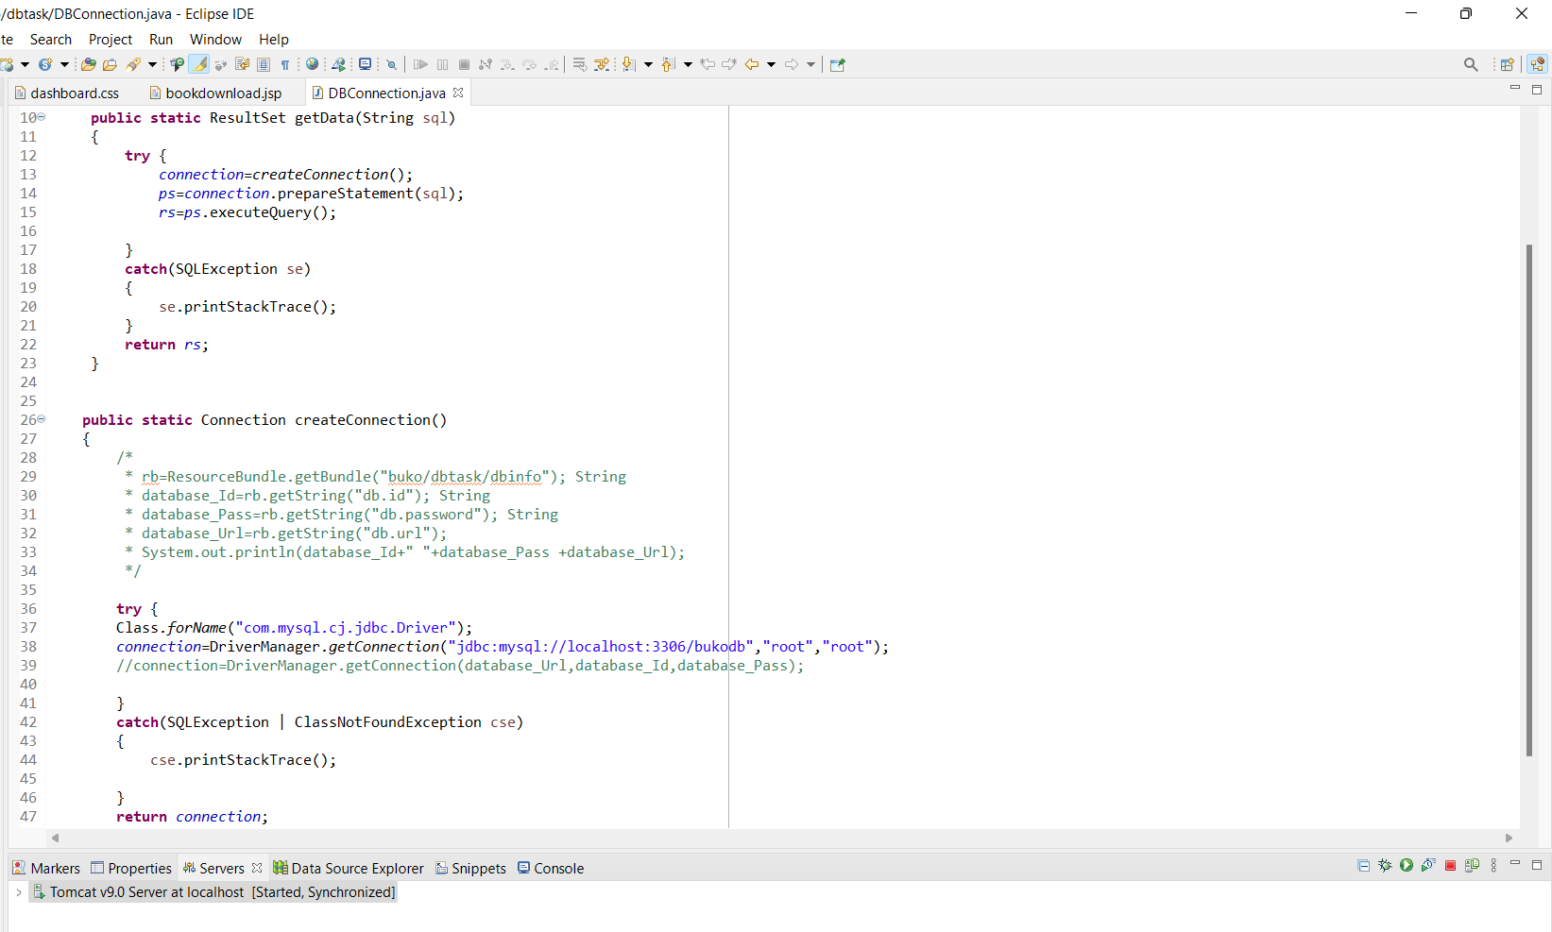
DB CONNECTION

Slide 12
Findings And Results
We are successfully designed user friendly website for content creator and users both.
An uploader and user both can upload the books and read the books.
We have used HTML,CSS & JAVASCRIPT for execution of codes .
Our platform is Eclipse ide.
Connection establish with the SQL.

Slide 13
Project Scope
Our main goal/scope is to open a trade across the Internet to facilitate the delivery of books, and to succeed with what we need to :
Increase profits by attracting greater number of customers though.
Using social media and online communities to engage with customers “like what we do in social platform”.
Saving users time & maintaining there intrests in their favorites writers.
Make and create a user friendly environment .
In future we also add payment and delivery methods .

Slide 14


